Slide 1

ME 361
MSc mechanical engineering
Industrial Machinery & Automation
Lecture 1
S. M. Sackey
sackeysm@yahoo.com // 0242 232 239

Slide 2
General Motion Equations
z
u
x
Z
Ω
y
X
Figure : A Moving Frame xyz Observed from a Fixed Frame XYZ
Y

Slide 3
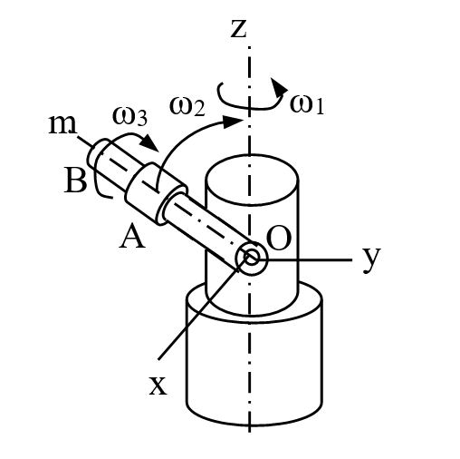
Linear, Angular Velocities, Transport Theorem
Example 1-1
Find the angular velocity and angular acceleration of sleeve A of Figure E1-1

Slide 4
Linear, Angular Velocities, Transport Theorem
Solution

Slide 5
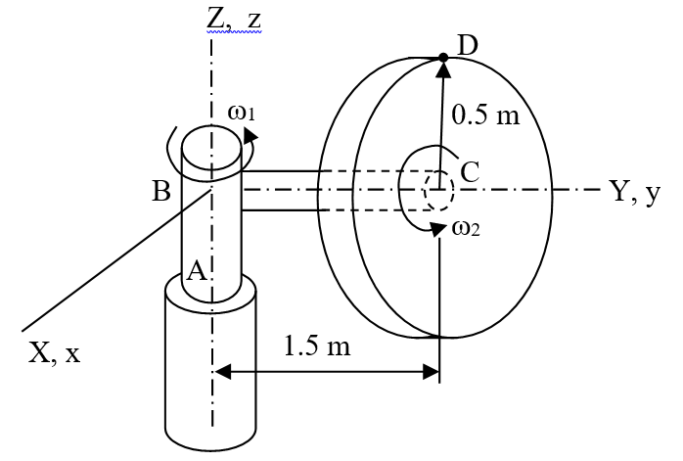
Linear, Angular Velocities, Transport Theorem
Example 1-2
The horizontal shaft BC in Figure E1-2 is rigidly attached to the vertical shaft AB. The vertical shaft AB rotates at a constant angular velocity ω₁ = 4 rad/s about the vertical axis while the disc mounted at the end of BC is rotates about the horizontal axis at ω₂ = 1 rad/s and α₂ =2 rad/s². Determine the angular velocity and acceleration of the disc.

Slide 6
Linear, Angular Velocities, Transport Theorem
Solution
The angular velocity of the sleeve is
Transport theorem
Using the transport theorem, the angular acceleration of the shaft is
of the arm OB is
Therefore the angular acceleration of the sleeve B which is being transported by both the shaft and the arm is

Slide 7
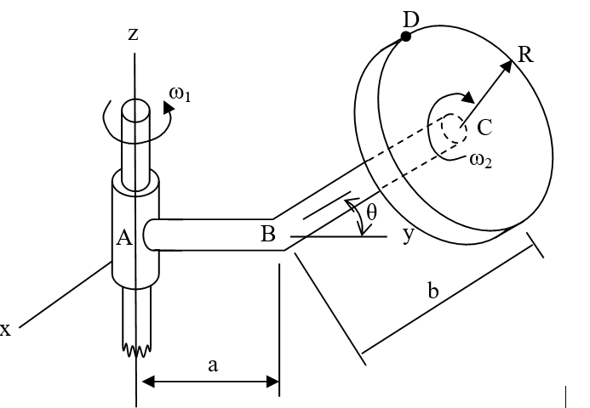
Linear, Angular Velocities, Transport Theorem
Example 1-3
In Figure E1-3, the bent pipe ABC is rigidly attached to a vertical shaft, which rotates with angular velocity ω₁ = 3 rad/s and angular acceleration α₁ = 1 rad/s² relative to the ground. The circular disc mounted at the point C rotates with constant angular velocity ω₂ = 5 rad/s relative to the bar. Knowing that θ = 30º, determine the
angular velocity of the disc relative to the ground
angular acceleration of the disc relative to the ground

Slide 8
Linear, Angular Velocities, Transport Theorem
Solution
Abs. angular velocity of the disc is
The angular acceleration of arm AB is
Similarly, the angular acceleration of the disc with respect to the fixed frame is

Slide 9
General Motion
Position and Displacement
r_{B} is the position of point A with reference to the origin of the fixed frame X, Y and Z
r_{A} is the position of point B with reference to the origin of the fixed frame X, Y and Z
r_{B/A} is the displacement of point B with reference to point A, the origin of the moving frame x, y and z

Slide 10
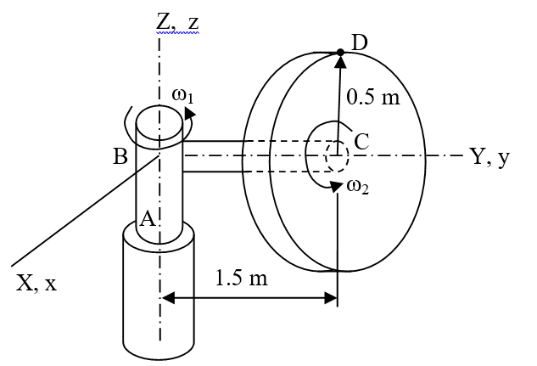
General Motion Examples
Example 1-4
Determine the velocity and acceleration of point D at the instant shown in Figure E1-4.

Slide 11
General Motion Equations
z
u
x
Z
Ω
y
X
Figure : A Moving Frame xyz Observed from a Fixed Frame XYZ
Y

Slide 12
General Motion Examples
Solution
From Example 1-2,
The velocity of point D becomes
The acceleration of point D is calculated as

Slide 13
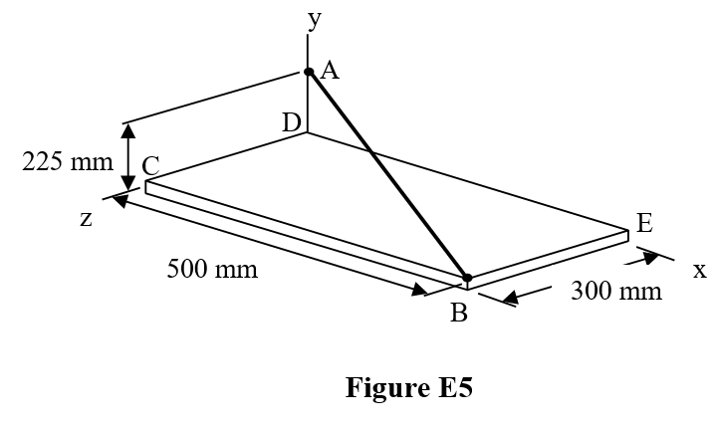
General Motion Examples
Example 1-5
The assembly shown in Figure E1-5 consists of two rods AB and AD, and a plate BCDE, which are welded together. If the assembly is rotating about AB with angular velocity is 15 rad/s anticlockwise, determine the velocity and acceleration of corner E.

Slide 14
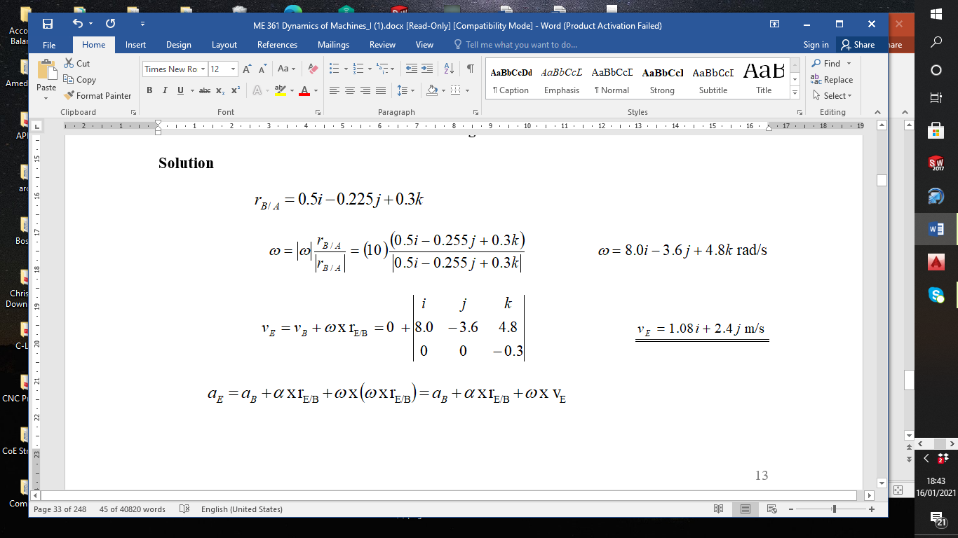
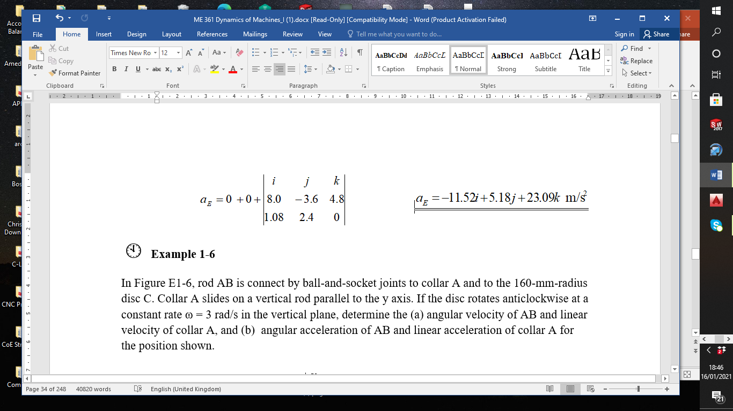
General Motion Examples

Slide 15
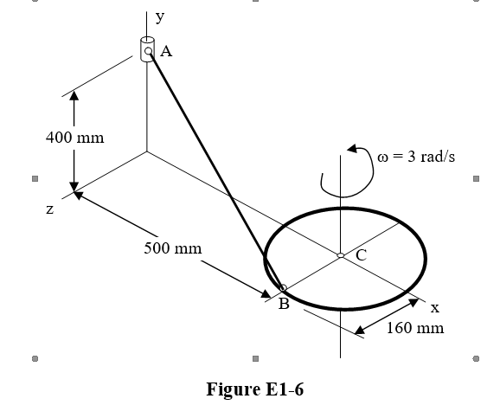
General Motion Examples
Example 1-6
In Figure E1-6, rod AB is connect by ball-and-socket joints to collar A and to the 160-mm-radius disc C. Collar A slides on a vertical rod parallel to the y axis. If the disc rotates anticlockwise at a constant rate ω = 3 rad/s in the vertical plane, determine the (a) angular velocity of AB and linear velocity of collar A, and (b) angular acceleration of AB and linear acceleration of collar A for the position shown.

Slide 16
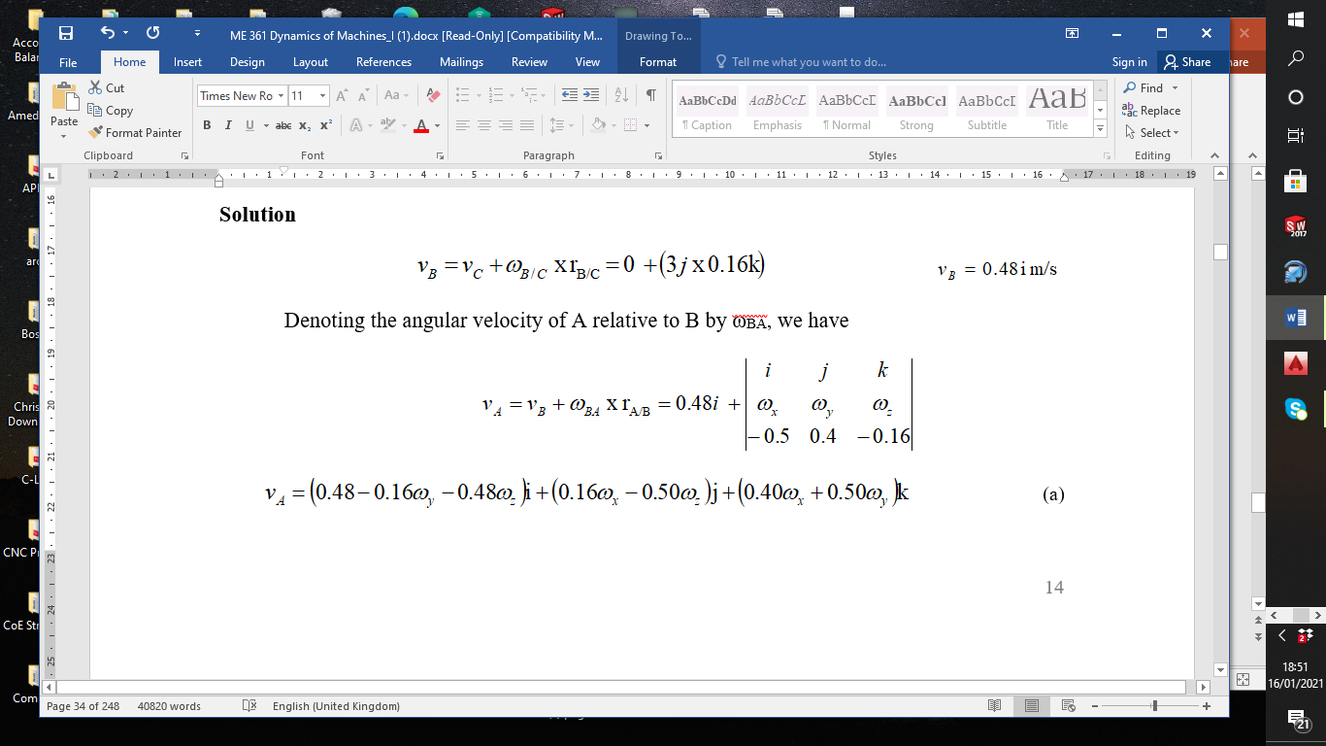
General Motion Examples

Slide 17
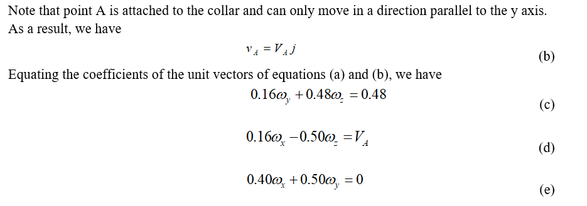
General Motion Examples
An additional equation is required, and is obtained by considering the constraint at point A. The connection at A allows rotation of BA about the vertical rod parallel to the y axis and about axis perpendicular to the plane containing the vertical rod and AB.

Slide 18
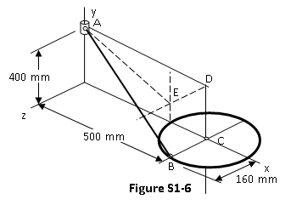
General Motion Examples
It prevents rotation of AB about the axis AE illustrated in Figure S1-6, which is perpendicular to vertical axis CD and lies in the plane of the vertical rod and AB. That is, the projection of angular velocity ω on r_{E/A} must be zero, which yields
(e)
(f)
Solving equations (c) to (f)
simultaneously, we have

Slide 19
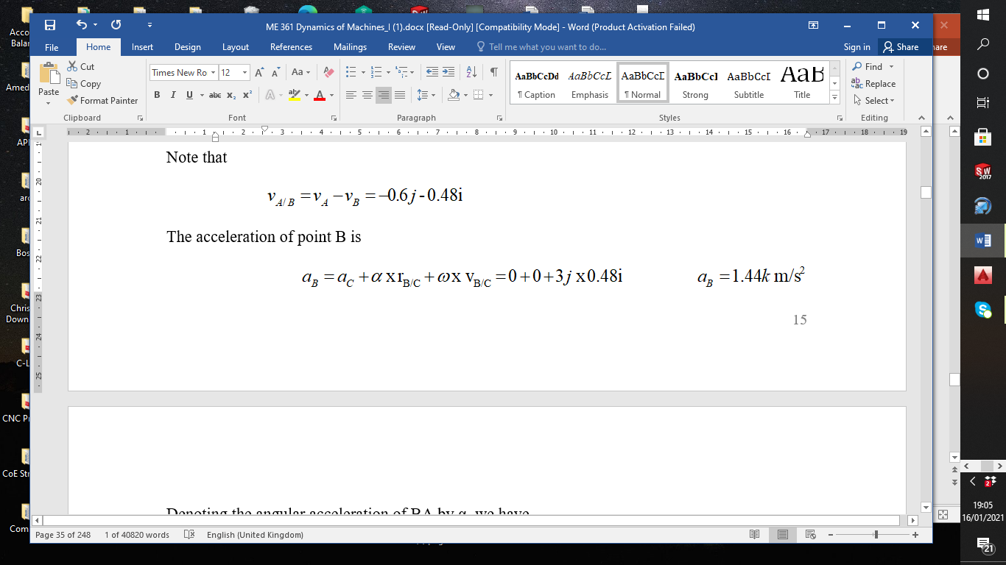
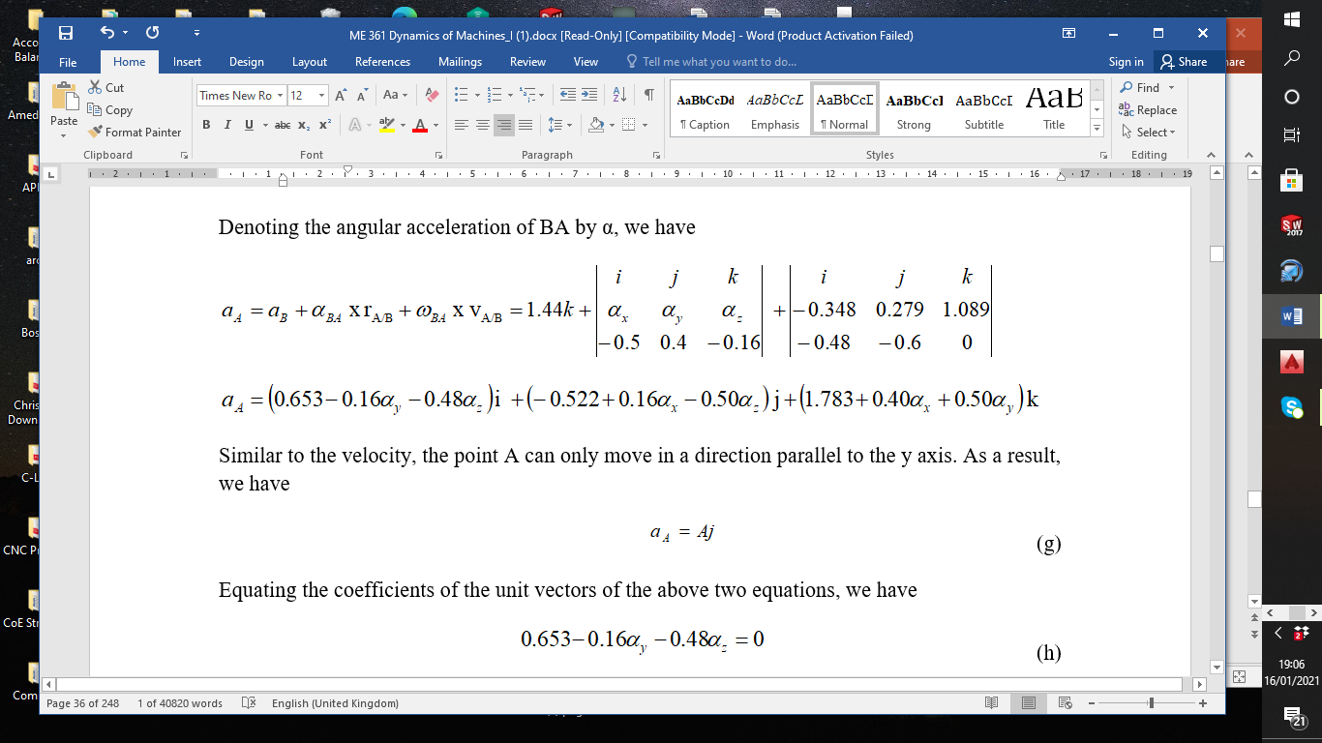
General Motion Examples

Slide 20
General Motion Examples

Slide 21
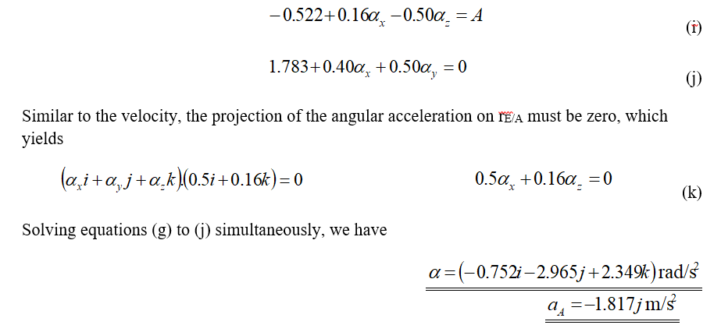
General Motion Examples

Slide 22
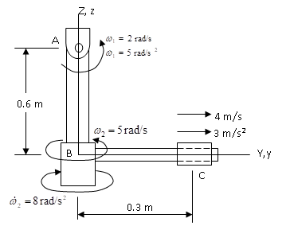
General Motion Examples
Example 1- 7
In Figure E1-7, the pendulum shown consists of two rods AB and BC. AB is pin supported at A, which allows AB to rotate only in the Y-Z plane. BC spins about the AB, and the sleeve at C slides on BC. Determine the velocity and acceleration of the sleeve at the instant shown.

Slide 23
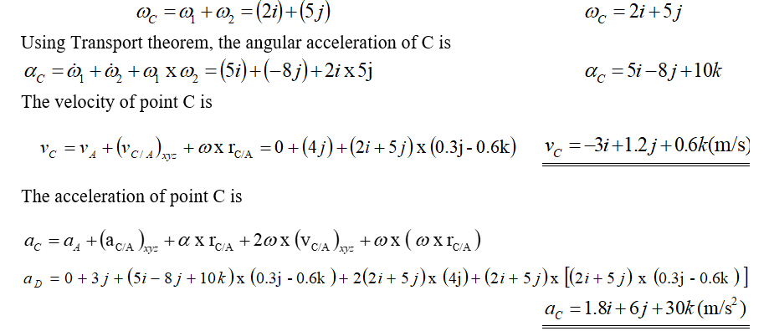
General Motion Examples
Solution
The angular velocity of C is

Slide 24
ME 361
MSc mechanical engineering
Industrial Machinery & Automation
Lecture 2

Slide 25
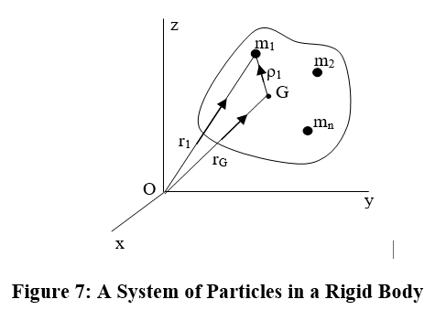
RIGID BODY GEOMETRY
Centre of Mass: Summation Method
The location of the centre of mass G is defined as
Equation 10
where
Equation 11
Note that r_{G} is a three-dimensional vector representing the x, y and z coordinates of the centre of mass. That is,

Slide 26
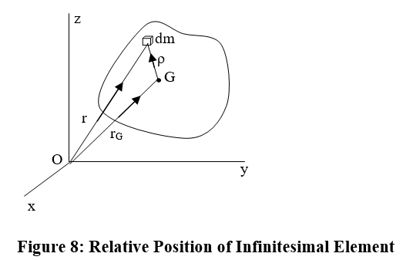
RIGID BODY GEOMETRY
Integration Method
Equations 10 and 11 are useful when the rigid body involved is constituted of discrete parts. As n→∞, each particle becomes dm (Figure 8). Then, the location of centre of mass G may be defined as
where

Slide 27
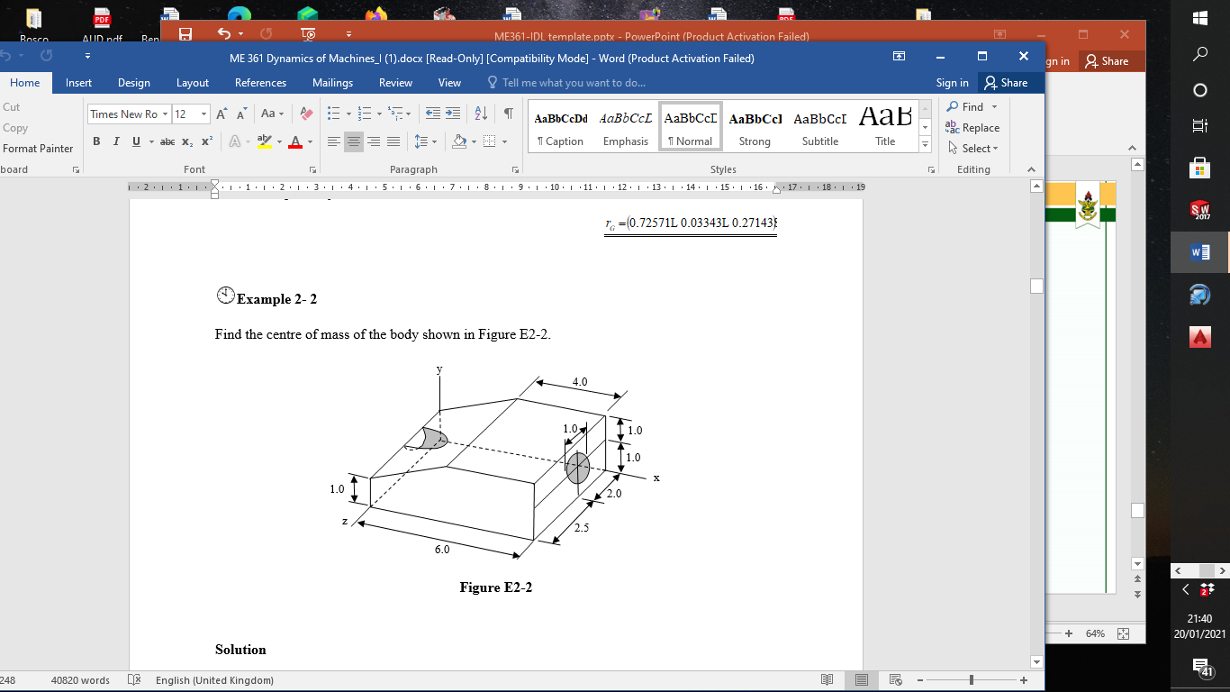
RIGID BODY GEOMETRY
Example 2- 2
Find the centre of mass
of the body shown in
Figure E2-2.

Slide 28

RIGID BODY GEOMETRY

Slide 29
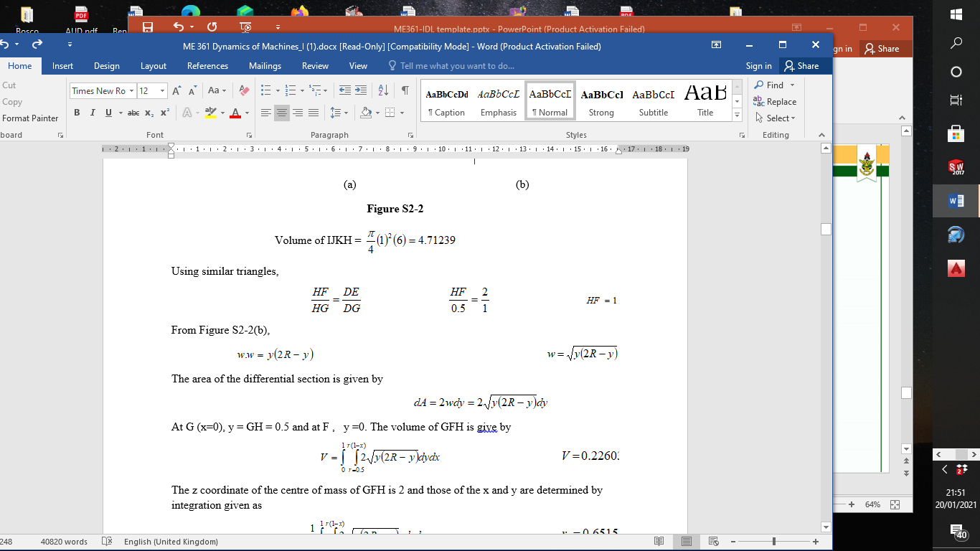
RIGID BODY GEOMETRY

Slide 30
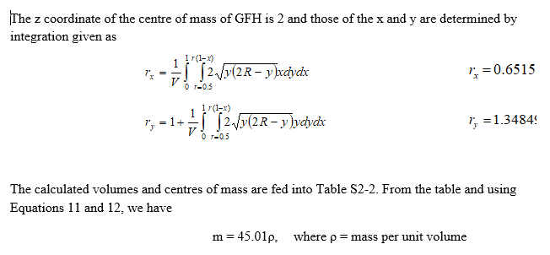
RIGID BODY GEOMETRY

Slide 31
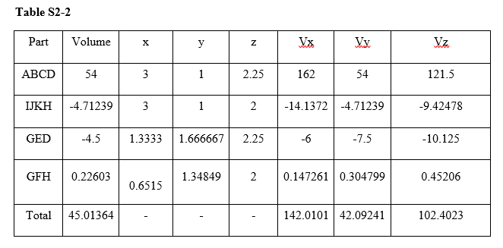
RIGID BODY GEOMETRY

Slide 32
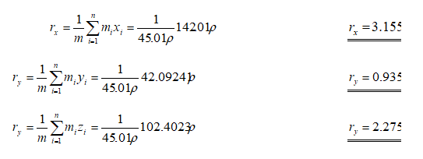
RIGID BODY GEOMETRY

Slide 33
RIGID BODY GEOMETRY
Velocity and Acceleration of Centre of Mass
The first and second derivatives of the earlier equations give
Discrete
Continuous
v_{G} and a_{G} are velocity and acceleration of the centre of mass of the body

Slide 34
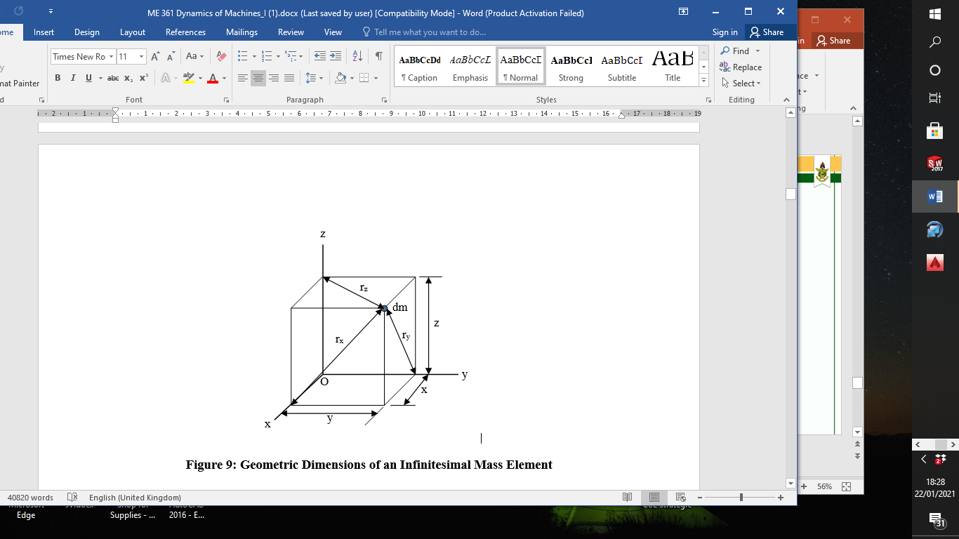
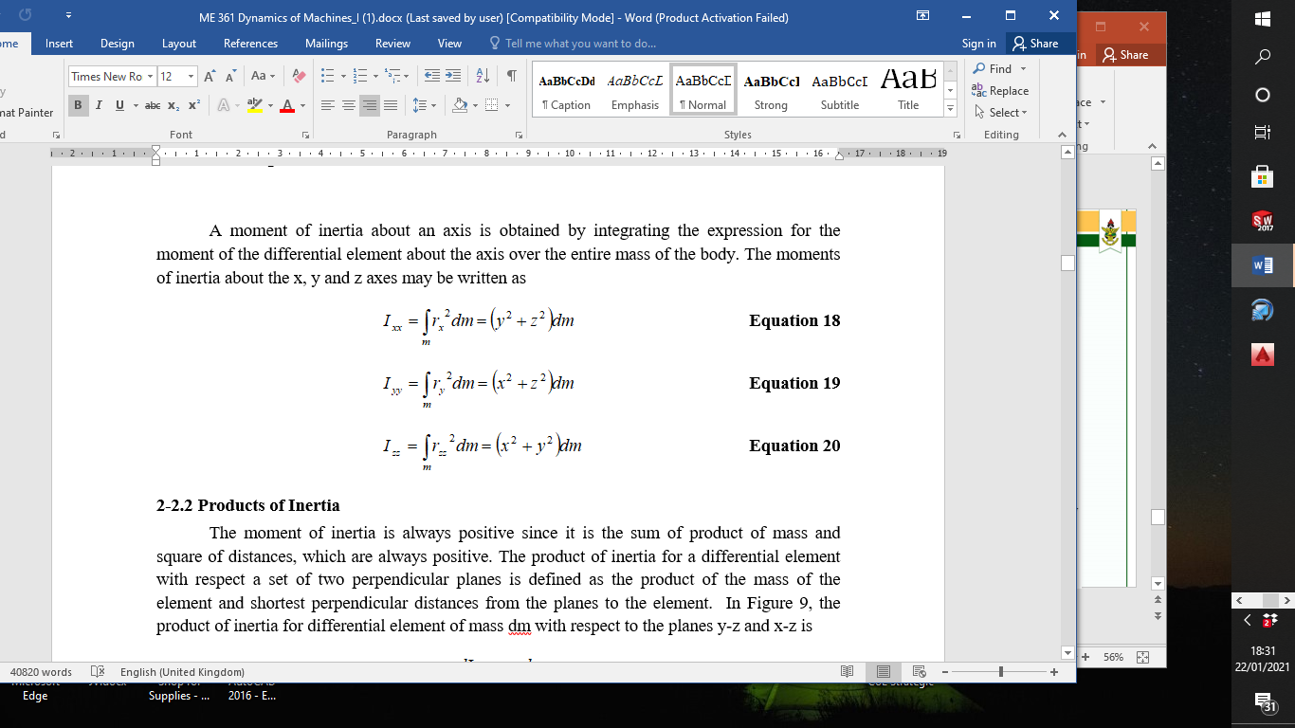
Moments of Inertia
The moment of inertia of differential element of mass dm about the x axis is
Figure 9: Geometric Dimensions of an Infinitesimal Mass Element

Slide 35
Products of Inertia
The product of inertia for differential element of mass dm with respect to the planes y-z and x-z is
Note that
since multiplication is commutative
The products of inertia for each combination of planes may be written as
Equation 21

Slide 36
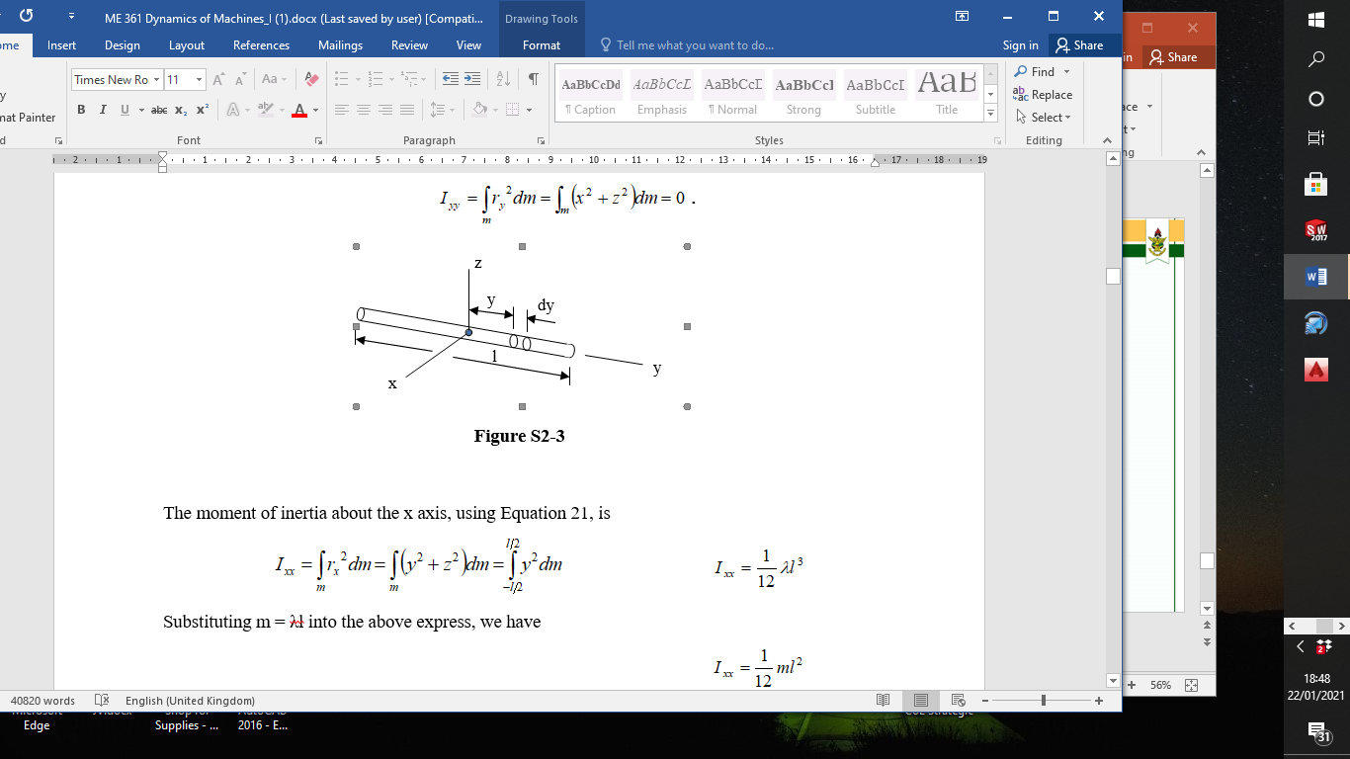
Moments & Products of Inertia
Example 2- 3
Find the moments and
products of inertia of a
slender of mass m and
length l about the
x, y and z axes through
the centre of mass.

Slide 37
Moments & Products of Inertia
If λ = mass per unit length, then dm = λdy, and if lateral dimensions are neglected, then
Substituting m = λl into the above express, we have
since x and z are zero

Slide 38
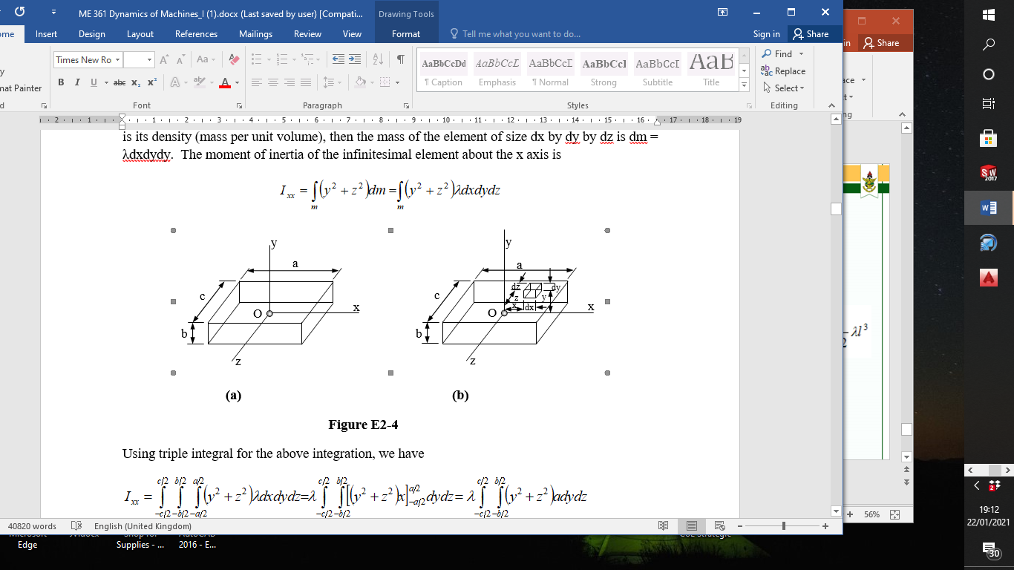
Moments & Products of Inertia
Example 2- 4
Find the moments and products of inertia of a rectangular prism of mass m and dimensions shown in Figure E2-4(a) about the x, y and z axes through the centre of mass.

Slide 40
Moments & Products of Inertia

Slide 41
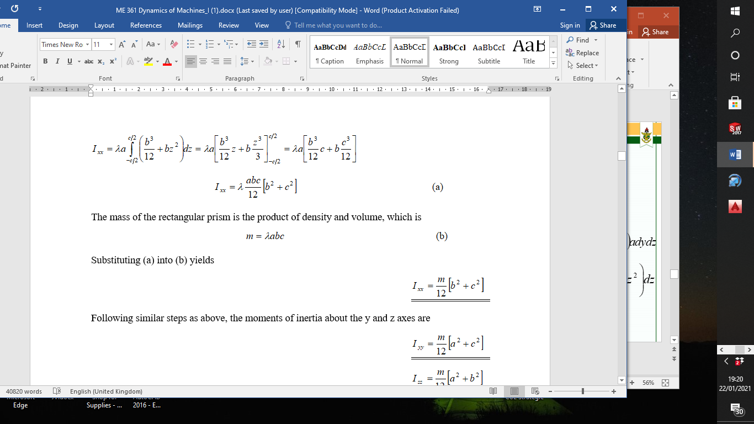
Moments & Products of Inertia
Substituting (a) into (b) yields
Following similar steps as above, we get

Slide 42
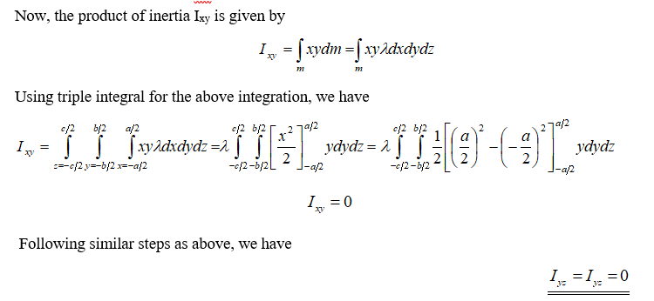
Moments & Products of Inertia

Slide 43
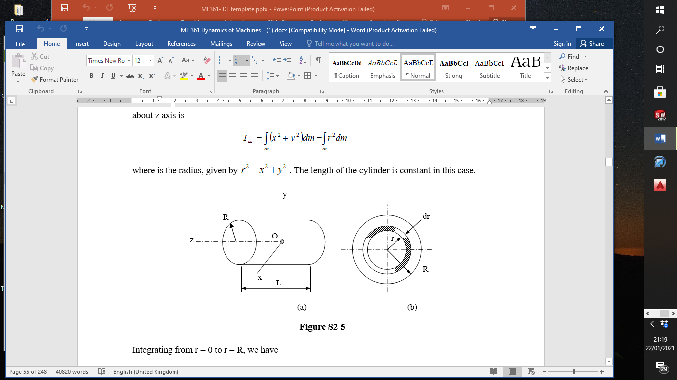
Moments & Products of Inertia
Example 2- 5
Find the three moments and the three products of inertia of a circular cylinder of mass m, length L and radius R about the x, y and z axes through the centre of mass.

Slide 44
Moments & Products of Inertia
Solution
Consider an infinitesimal ring of width dr at r radius from the centre of the cylinder. If λ is the density (mass per unit volume) of the cylinder, then the mass of the infinitesimal ring is

Slide 45
Moments & Products of Inertia
The moment of inertia of the infinitesimal ring about z axis is
where is the radius is
L is constant.
Integrating from r = 0 to r = R, we have

Slide 46
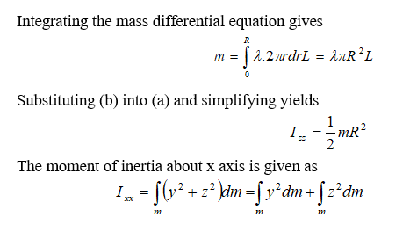
Moments & Products of Inertia

Slide 47
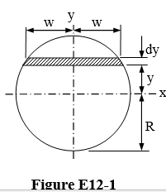
Moments & Products of Inertia
The moment of inertia of the infinitesimal section shown in Figure 2.5 is given by
where dm=λL(2w)dy .

Slide 48
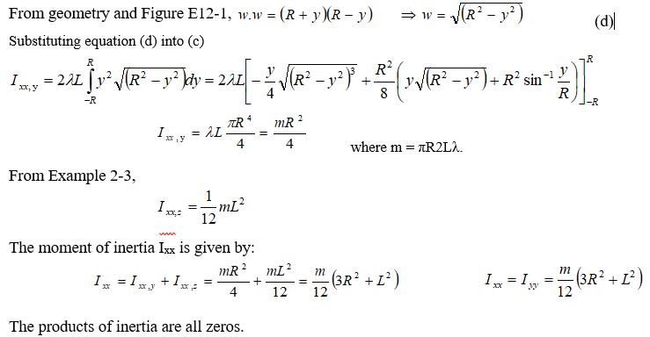

Slide 49
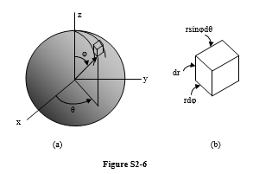
Moments & Products of Inertia
Example 2- 6
Find the moments and products of inertia of a uniform rigid sphere of mass m and radius R about the x, y and z axes through the centre of mass.

Slide 50
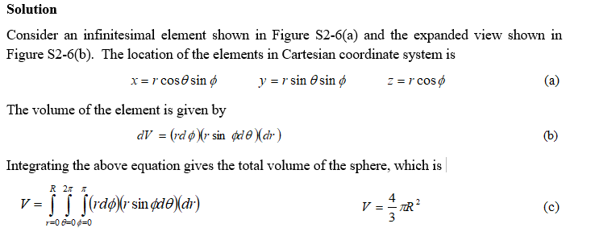
Moments & Products of Inertia

Slide 51
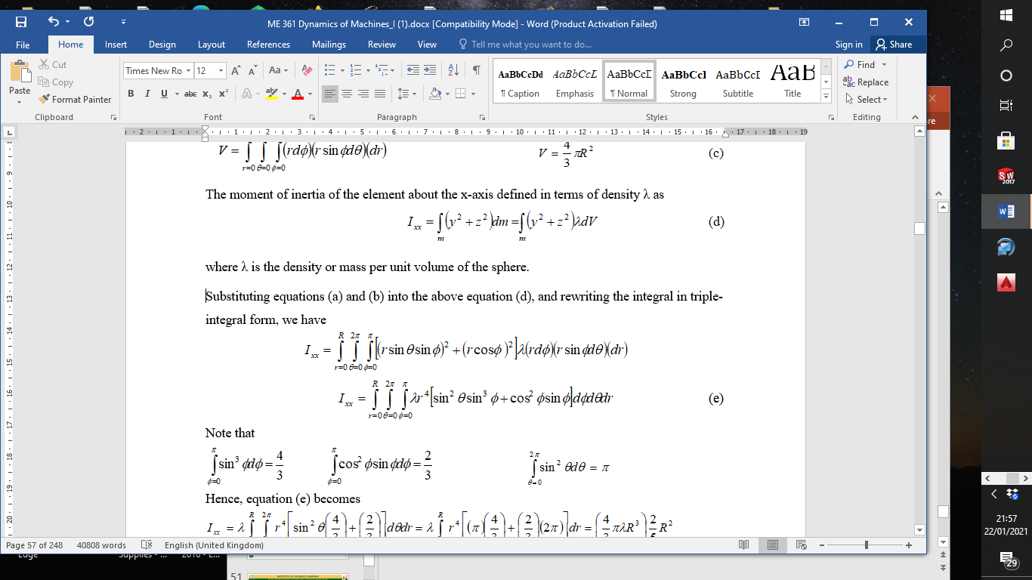

Slide 52
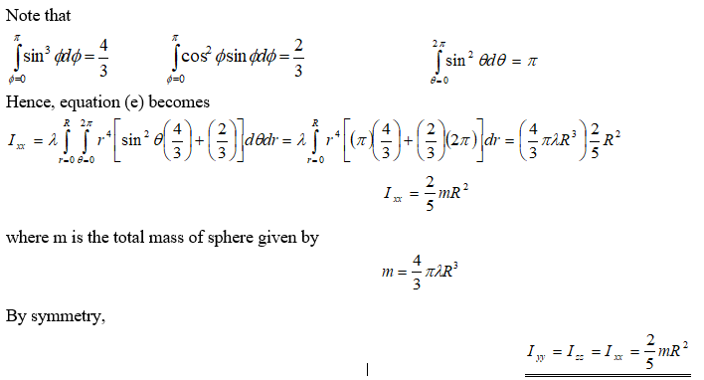

Slide 53
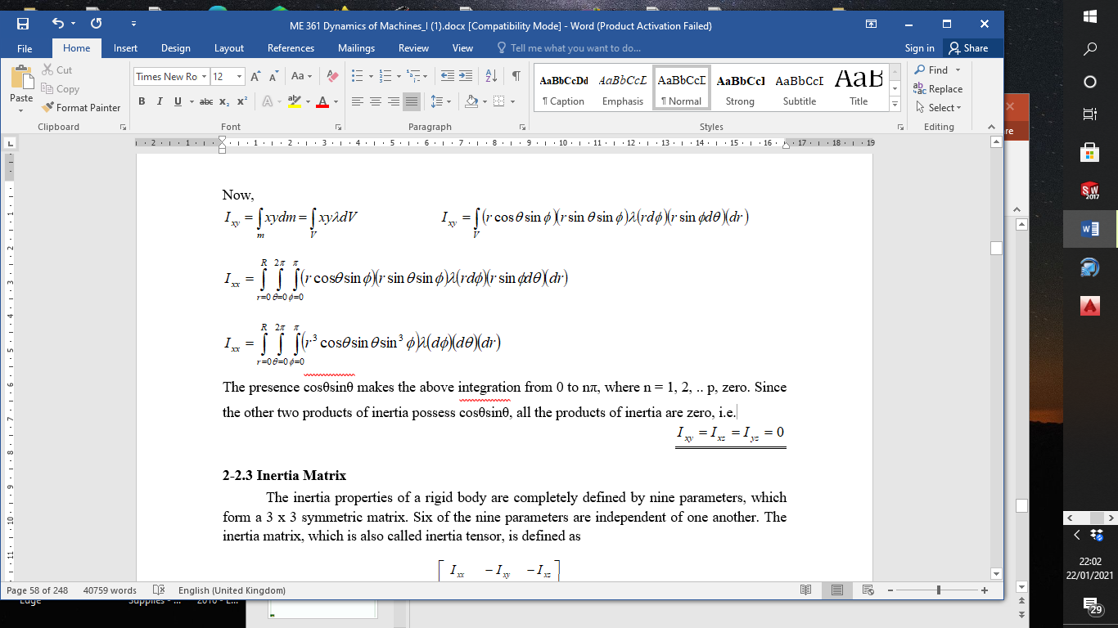
Moments & Products of Inertia

Slide 54
Inertia Matrix
The inertia matrix (inertia tensor) is defined as
Example 2- 7
Find the inertia matrix of Example 2-3.
Solution
From Example 2-3,
So

Slide 55
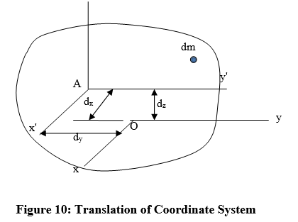
Transformation of Mass Moments of Inertia
Translation of Coordinate
The coordinates systems are
parallel such that x'= x- d_{x},
y'= y- d_{y} and z'= z+ d_{z}. then

Slide 56
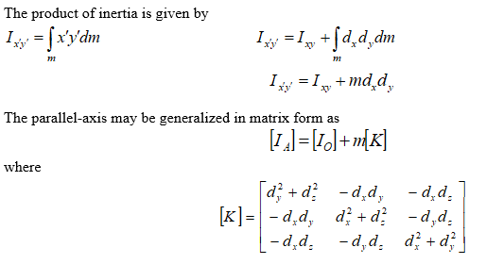
Transformation of Mass Moments of Inertia

Slide 57
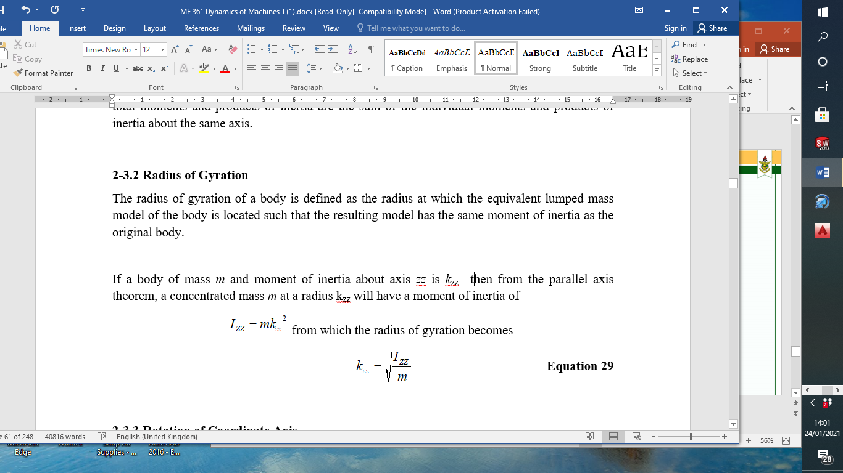
Radius of Gyration

Slide 58
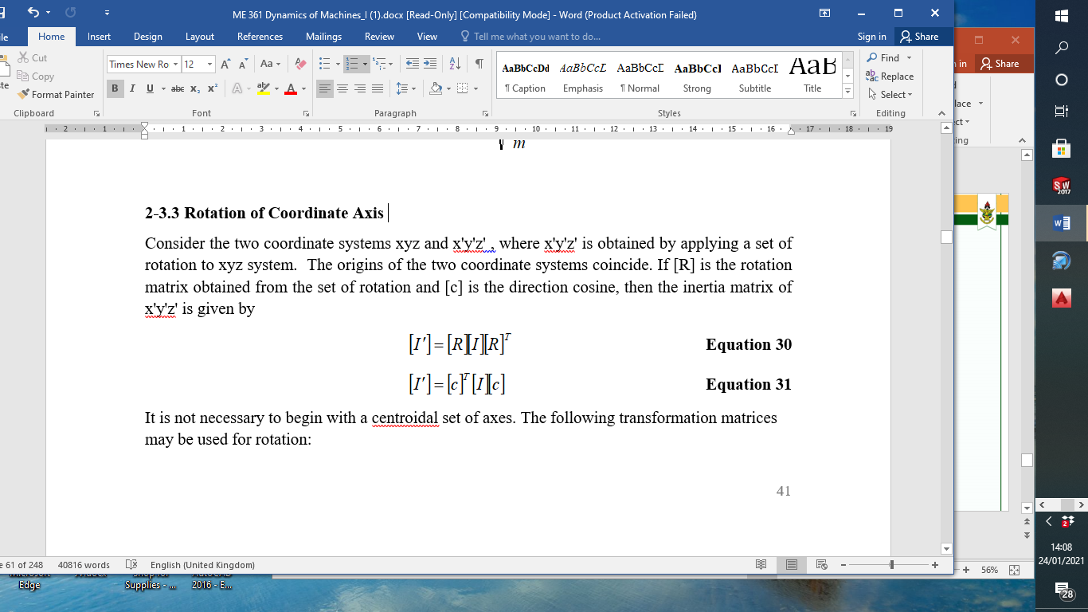
Rotation of Coordinate Axis

Slide 59
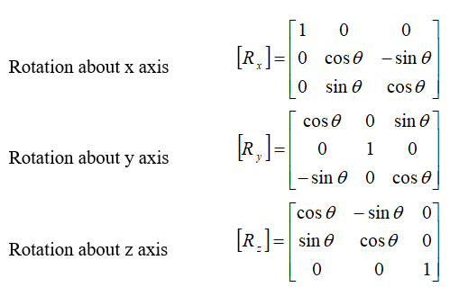
Rotation of Coordinate Axis
It is not necessary to begin with a centroidal set of axes. These matrices may be used for rotation:

Slide 60
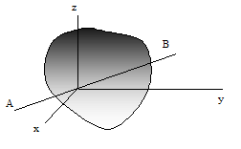
Moment of Inertia about an Arbitrary Axis
If u_{x}, u_{y} and u_{z} are unit directional vector of axis AB then the moment of inertia of the body about that axis is defined in terms of that of known axes as

Slide 61
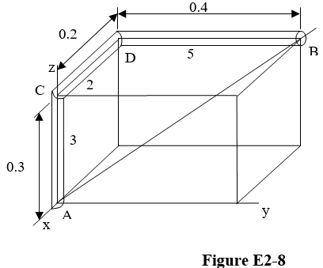
Moment of Inertia about an Arbitrary Axis
Example 2- 8
Determine the moment of inertia of the bent bar shown in Figure E2-8 about the axis AB. The mass and length of each segment is shown on the figure.

Slide 62
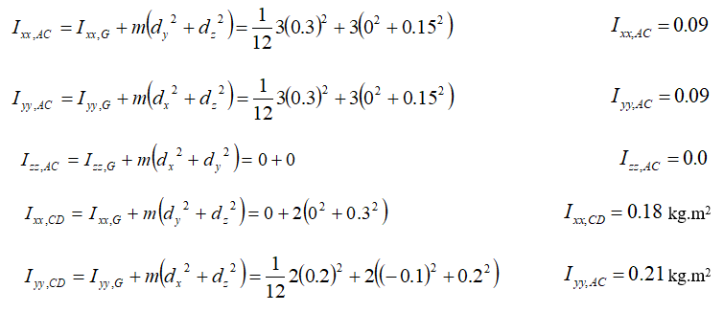
Moment of Inertia about an Arbitrary Axis
Solution
Using the parallel axis theorem, the moment of inertias of the sections of the bar about the origin are:

Slide 63
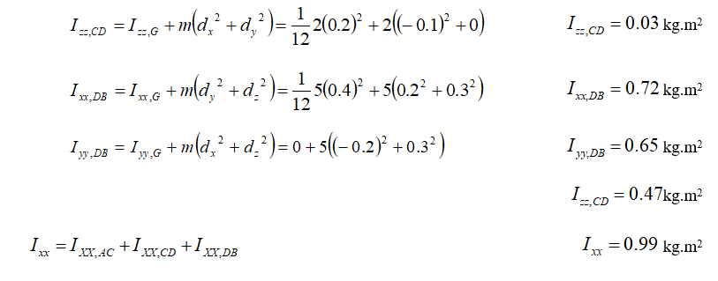
Moment of Inertia about an Arbitrary Axis

Slide 64
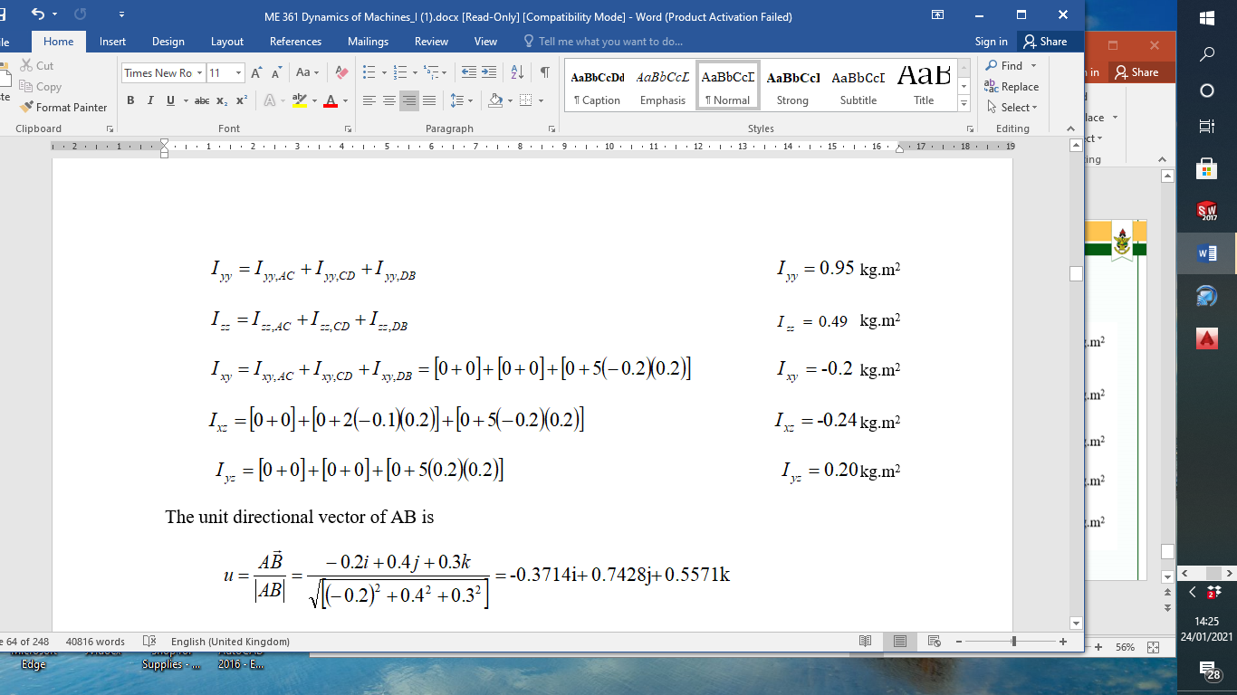
Moment of Inertia about an Arbitrary Axis

Slide 65
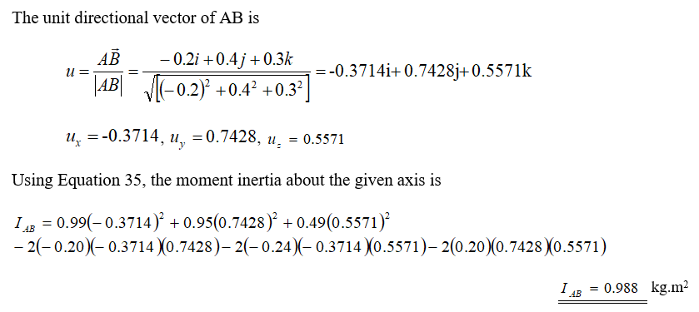
Moment of Inertia about an Arbitrary Axis

Slide 66
Principal Moments of Inertia
When all the products of inertia vanish (or equal to zero), the moment of inertia I_{xx}, I_{yy} and I_{zz} are called principal moments of inertia
the corresponding axes x, y and z are called principal axes.
The principal moments of inertia may be obtained by inspection to select axes such that they lie on planes of symmetry
Alternatively,

Slide 67
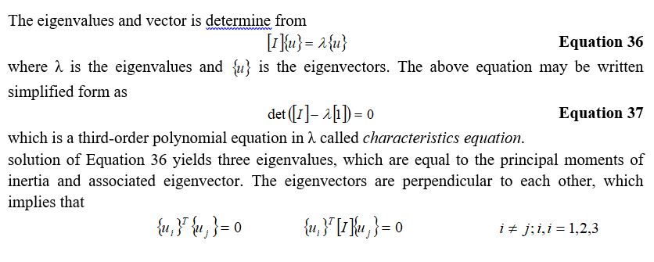
Principal Moments of Inertia

Slide 68
Principal Moments of Inertia
Example 2- 9
Find the principal moments of inertia of a body whose inertia matrix is given by
Solution
Using Equation 37, we have
λ₁= I_{xx} = 222.09, λ₂= I_{yy} = 495.5, λ₃= I_{zz} = 532.3

Slide 69
ME 361
MSc mechanical engineering
Industrial Machinery & Automation
Lecture 3

Slide 70

Equations of Translational Motion

Slide 71


Equations of Rotational Motion
The angular momentum of a body (H) is defined as the moment of linear momentum of the body.
From Newton Second Law: The Algebraic sum of moments acting on a body is directly proportional to the rate of change of angular momentum of that body.
$$\sum{M}=\frac{dH}{dt}$$
$$H=\sum{(ρ_{i}×m_{i} v)}$$
$$H=\sum{(ρ_{i}×m_{i} (ω×ρ_{i}))}$$

Slide 72


Angular Momentum(H) of an Arbitrary Point A

Slide 73
Rectangular Components of H
Case1; A coincides with G ⇒

Slide 74
Rectangular Components of H cont’d…

Slide 75
Rectangular Components of H cont’d…
Case 2; point A is fixed
The value of H is the same as in case 1, with the new axes at the fixed point
Case 3; the principal axes are chosen as the axes of rotation

Slide 76


FUNDAMENTAL EQUATIONS OF MOTION OF A 3-D RIGID BODY
$$\sum{F=ma_{G}} ;\sum{M}=\frac{dH}{dt}$$
Let ω be the angular velocity of the body and Ω the angular velocity of the frame.

Slide 77
EQUATIONS OF MOTION OF A 3-D RIGID BODY cont’d…

Slide 78
EQUATIONS OF MOTION OF A 3-D RIGID BODY cnt’d
CASES
Case 1; principal axes are chosen as the axes of rotation,
Case 2; constant angular velocity,
Case 3; frame rotating with the same angular velocity of body,
Case 4; fixed frame
Case 5; fixed axes rotation

Slide 79
EULER’S EQUATIONS OF MOTION
If the x, y, and z axes are chosen to coincide with the principal axes of inertia of the body(centroid), the angular momentum

Slide 80


Worked Example 1
1. A student holds a 5-kg hot rectangular plate with a tong (not shown) at point O in the Figure below. Find the couple exerted on the plate by the tong at the instant the plate is horizontal and moving at angular velocity and acceleration of 5i -3j + 4 k (rad/s) and -5 i +5j – 2k (rad/$s^{2}$), respectively.

Slide 81

Worked Example 1 cont’d
Solution
The moments and products of inertia about point O are

Slide 82

Worked Examples cont’d Solution to 3.1 cont’d
Let the force and couple acting on the plate at the point of contact with the manipulator respectively be F and C. The total moment about point O of the free-body shown is

Slide 83

Worked Examples cont’d Solution to 3.1 cont’d

Slide 84
Worked Example 2
2. The 10-kg thin cylinder shown below rotates about the shaft at a constant speed of ω_{s} = 6 rad/s. At the same time, the shaft is rotating about the vertical axis about an axis through A with an angular velocity ω_{p} = 3 rad/s. If A is thrust bearing and B is a journal bearing, determine the components of force reaction at each bearing due to the motion.

Slide 85
Solution 2
Free-body diagram of the cylinder and the shaft is shown in the Figure below. In the figure the origin of the coordinate systems coincide at the centre of mass G of the cylinder. Thus, the products of inertia are equal to zero.

Slide 86
Solution 2 cont’d…
The moments of inertia are:

Slide 87
Solution 2 cont’d…

Slide 88

Solution 2 cont’d…
From the free body diagram
$$\sum{F_{x}=0; }A_{x}+B_{x}=0 ………1$$
$$\sum{F_{y}=0; }A_{y}+mω^{2}r=0⇒A_{y}=−10\left(3^{2}\right)x0.5=−45 N………2$$
$${\sum{F_{z}=0; }A}_{z}+B_{z}=98.1 ………3$$
$$\sum{M_{x}=0; }{0.5(B}_{z}−A_{z})=−3.6 ………4$$
$$\sum{M_{y}=0; }0=0 ………5$$
$${\sum{M_{z}=0; }A}_{x}−B_{x}=0 ………6$$
Solving these equations simultaneously, we obtain
$$A_{x}=B_{x}=0$$
$$A_{z}=52.65 N;B_{z}=45.45 N$$
$$A_{y}=−45 N$$

Slide 89






GYROSCOPIC MOTION
For a body rotating about a fixed point, the axis of rotation will always pass through the fixed point, but the body's orientation will not remain fixed.
(a) Precession
(b) Nutation
(c) Spin
From (a)
$$ω_{z′}=\dot{ϕ}$$
From (b)
$$ω_{x′′}=\dot{θ};$$
$$ω_{y′′}=\dot{ϕ}sinυ$$
$$ω_{z′′}=\dot{ϕ}cosυ$$
From (c)
From (d) the angular velocities relative to the rotating frame of reference xyz
$$ω_{x}=ω_{x′′′}=\dot{ϕ}sinυsinχ+\dot{υ}cosχ$$
${{ ω}_{y}=ω}_{y′′′}=\dot{ϕ}sinυ$ $cosχ−\dot{υ}sinχ$
$$ω_{z}=ω_{z′′′}=\dot{χ}+\dot{ϕ}cosυ$$
(d)

Slide 90



GYROSCOPIC MOTION cont’d…
Since the coordinate axes are embedded in the body ⇒ ω = Ω;
However if the reference frame is chosen such that it only
Follows the motion of the body in precession and nutation.
$$\dot{χ}=0,\text{and} \text{select} χ=0$$
$$ω_{x}=\dot{θ};$$
$$ω_{y}=\dot{ϕ}sinυ$$
$$ω_{z}=\dot{ϕ}cosυ+\dot{χ}$$
$$Ω_{x}=\dot{θ};$$
$$Ω_{y}=\dot{ϕ}sinυ$$
$$Ω_{z}=\dot{ϕ}cosυ$$

Slide 91




GYROSCOPIC MOTION cont’d…
Case 1-1: Steady Precession
$\dot{ϕ}=constant;υ=constant$; $\dot{χ}=constant$
Case 1-2: Steady Precession with $={90}^{o}$
$\dot{ϕ}=constant;υ={90}^{o}$; $\dot{χ}=constant$

Slide 92

GYROSCOPIC MOTION cont’d…
Case 1-3: Steady Precession with no external moment (torque free motion)-spacecraft, projectiles, satellites, spinning football, bullet etc,.

Slide 93


Worked Example 3
A top of mass of 0.5 kg is precessing about the vertical axis at a constant angle of 60º, as shown in below. If it spins at ω_{s} = 100 rad/s, determine the precessional velocity ω_{p}. Assume that the axial and transverse moments of inertia of the top are 0.45 x 10⁻³ kg.m² and 1.20 x 10⁻³ kg.m², respectively, measured with respect to the fixed point O.
FBD

Slide 94
Solution 3 cont’d…
From the FBD above, the coordinate system is established such that the vertical points toward the positive Z direction, which is the axis of precession. Based on the coordinated system, the following given data are; I_{xx} = 1.20 x 10⁻³ kg.m², I_{zz} = 0.45 x 10⁻³ kg.m², m = 0.5 kg, h = 50 mm, θ = 60º. Assuming that the motion is a steady precession, the sum moments about point O is
In reality, the low precession angular velocity would occur since that requires lower
kinetic energy. Hence,

Slide 95



Worked Example 4
The wheel shown in (a) has mass 1kg. It rotates at end D of the shaft with angular velocity of 70 rad/s in the direction shown. A non-rotating body of mass 2 kg is placed on the shaft a distance s from the point of rotation of the shaft. Neglecting the mass of the shaft, determine the position s that will enable the wheel to have a steady processional velocity.

Slide 96

Worked Example 5
A young man threw a cocoa pod and the motion of it is observed to be directed 30º from the horizontal, while it is precessing about the vertical axis at 3 rad/s, as shown in the Figure. Neglecting the effect of air resistance and knowing that the ratio of the axial to transverse moments of inertia of the cocoa pod is 1/3 measured from the centre of mass, determine the magnitude of the spin of the pod and its angular velocity.

Slide 97
Solution

Slide 98
Gyroscopic Effects in Machines
Worked Example 6
The turbine rotor of a ship has a mass of 30 t, a radius of gyration of 600 mm, and rotates at 2400 rev/min in a clockwise direction when viewed from aft. The ship pitches through a total of 15°, 7.5° above and 7.5° below the horizontal, the motion being simple harmonic and having a period of 12 s. Determine the maximum gyroscopic couple on the holding down bolts of the turbine.
Solution

Slide 99


Worked Example 7
A motor bike and its rider have mass 250 kg goes around the circular at the entrance to the Kwame Nkrumah University of Science and Technology, Kumasi, at speed of 100 km/h. The combined centre of gravity of the rider and the bike is 0.6 m above the road surface when the vehicle is vertical. Each wheel has a radius of 0.25 m and moment of inertia of 1.2 kg-m², and the engine’s flywheel has moment of inertia of 0.3 kg-m² and rotating at 5 times the speed of the wheels and in the same direction. Find the maximum angle of turn if the radius of turn is 40 m.
$${Gyroscopic couple, C}_{g}=IωΩ \\ C_{g}cosα+m\frac{v^{2}}{R}hcosα=mghsinα$$
$$C_{g}=C_{g,wheel}+C_{g,flywheel}$$
$$C_{g}=2x1.2×\frac{100×\frac{5}{18}}{0.25}×\frac{100×\frac{5}{18}}{40}+0.3×5×\frac{100×\frac{5}{18}}{0.25}×\frac{100×\frac{5}{18}}{40}$$
$$C_{g}=300.926 Nm$$
$$m\frac{v^{2}}{R}h=250×\frac{{\left(100×\frac{5}{18}\right)}^{2}}{40}×0.6=2893.519 N$$
$$mgh=250×9.81×0.6=1471.5 N$$
$$tanα=\frac{3194.445}{1471.5}; ⇒α=65.267^{o}$$

Slide 100
Worked Example 7

Slide 101

Worked Example 8
A four wheel automobile is travelling along the Suame circle in Kumasi, which has a mean radius of 40 m. Each wheel has a moment of inertia of 2.0 kg-m² and effective radius of 0.25 m. The rotating parts of the engine have a moment of inertia of 1.0 kg-m². The axis of rotation of the engine is parallel to the rear axle and the crankshaft rotates in the same sense as the wheels. The ratio of engine speed to the back axle speed is 3:1. The automobile has a mass of 1500 kg, its centre of gravity is 0.5 m above the road level and the distance between the inner and outer wheels is 1.1 m. The centre of gravity of the automobile lies at middle of the back axle and at d/3 from the front wheel, where d is distance between the front and rear wheels. Determine the maximum speed the automobile can travel around the circle for the four wheels to maintain contact with the ground.

Slide 102
Worked Example 8

Slide 103


ASSIGNMENT 1
An experimental Fresnel-lens solar-energy concentrator can rotate about the horizontal axis AB which passes through its mass center G. It is supported at A and B by a steel framework which can rotate about the vertical y axis. The concentrator has a mass of 30 Mg, a radius of gyration of 12 m about its axis of symmetry CD, and a radius of gyration of 10 m about any transverse axis through G. Knowing that the angular velocities $ω_{1}$ and $ω_{2}$ have constant magnitudes equal to 0.20 rad/s and 0.25 rad/s, respectively, determine for the position = 60° (a) the forces exerted on the concentrator at A and B, (b) the couple applied to the concentrator at that instant.

Slide 104


ASSIGNMENT 2
A 2.4-kg piece of sheet steel with dimensions 160 x 640 mm was bent to form the component shown. The component is at rest (ω = 0) when a couple ${\text{M}}_{o}$= (0.8 N m) k is applied to it. Determine
the angular acceleration of the component
the dynamic reactions at A and B immediately after the couple is applied.

Slide 105
ASSIGNMENT 3
The turbine rotor of a ship has a mass of 20 t, has a radius of gyration of 0.6 m and rotates at 3600 rpm. The ship is pitching 10° above and 10° below the horizontal, the motion being simple harmonic and having a period of 12s.The rotor turns in a clockwise direction when viewed from aft. Determine
(a) maximum angular velocity of ship during pitching
(b) the maximum angular acceleration of ship during pitching
(c) the maximum value of the gyroscopic couple stating its plane of action
(d) the direction of yaw as the bow rises.

Slide 106

ASSIGNMENT 4
The following particulars are given for a motor vehicle: total mass, 1.5 t; wheel base, 3.2 m; track width, 1.5 m; centre of gravity 1.8 m behind the front axle and 0.95 m above road level; moment of inertia of two front wheels, 10 kg $m^{2}$; moment of inertia of two rear wheels, 15 kg $m^{2}$; moment of inertia of parts turning at engine speed, 2 kg $m^{2}$; wheel diameter, 0.64 m, gear ratio from engine to road wheels, 10 to 1. The engine turns in a clockwise direction when viewed from the front of the vehicle. The vehicle travels at a constant speed of 80 km/h and enters a right-hand curve of 150 m radius.
Determine: (a) the vertical load on each wheel, taking into account
(i) gravitational effects ;
(ii) centrifugal effects ;
(iii) the gyroscopic effect due to the engine rotation;
(b) the rolling couple acting on the vehicle due to the gyroscopic
effect of the road wheels.

Slide 107

ASSIGNMENT 5
The angular velocity vector of a football which has just been kicked is horizontal, and its axis of symmetry OC is oriented as shown. Knowing that the magnitude of the angular velocity is 200 rpm and that the ratio of the axis and transverse moments of inertia is I/I’= 1/4, determine (a) the orientation of the axis of precession OA, (b) the rates of precession and spin.

Slide 108


ASSIGNMENT 6
The gyro rotor is spinning at the constant rate p=100 rpm relative to x-y-z axes in the direction indicated. If the angle γ between the gimbal ring and horizontal X-Y plane is made to increase at the rate of 4 rad/s and if the unit is forced to precess about the vertical at the constant rate of 20 rpm, calculate the applied torque on the rotor when γ=${30}^{o}; I_{xx}=0.5 kgm^{2},I_{zz}=0.3 kgm^{2}$.

Slide 109

Thank You
For any concerns, please contact
elearning@knust.edu.gh
elearningknust@gmail.com
0322 191132

